Slide 1
Smart Home Lighting System Using Clap Detection

Slide 2
GROUP 10
Group Members
Awuah Godfred
Kusi Adumhene Asamoah
Atafo John Anyinebora
Arhin Emmanuel Addai Mensah
Awumbila Alfred Wusuyado
Duah Eugene
Ennin Richard Kwaku
Appiah Gideon
Awuah Justin Owusu Afriyie

Slide 3
Table of Contents
1. Introduction
2. Problem Statement
3. Methodology
4. System Components
5. Circuit Design
6. System Flow
7.Code
8. Code Overview
9. Demonstration / Simulation
10. Results, Challenges, and Possible improvement
11. Conclusion

Slide 4
Introduction
Smart home systems are designed to improve convenience and automation in homes.
This project focuses on controlling lighting using sound detection.
A clap sound is detected by a sensor and processed by an Arduino to control a light (LED).

Slide 5
Problem Statement
Traditional lighting systems require manual switches.
This can be inconvenient when:
- The switch is far away
- The user's hands are occupied
- Accessibility is required
This project proposes a clap-controlled lighting system.

Slide 6
Methodology
The system operates using the following process:
1. A clap sound is detected by the sound sensor.
2. The sensor sends a signal to the Arduino.
3. The Arduino processes the input signal.
4. The LED light is toggled ON or OFF.

Slide 7
System Components
Hardware used in the project:
- Arduino Uno
- Sound Sensor Module
- LED
- Breadboard
- Jumper Wires
Software used in the project:
-Arduino IDE

Slide 8
Circuit Design
Summary of Connections:
Sound Sensor:
VCC → 5V (Arduino)
GND → GND
OUT → Pin 3
LED connection:
Anode → Pin 13
Cathode → GND

Slide 9
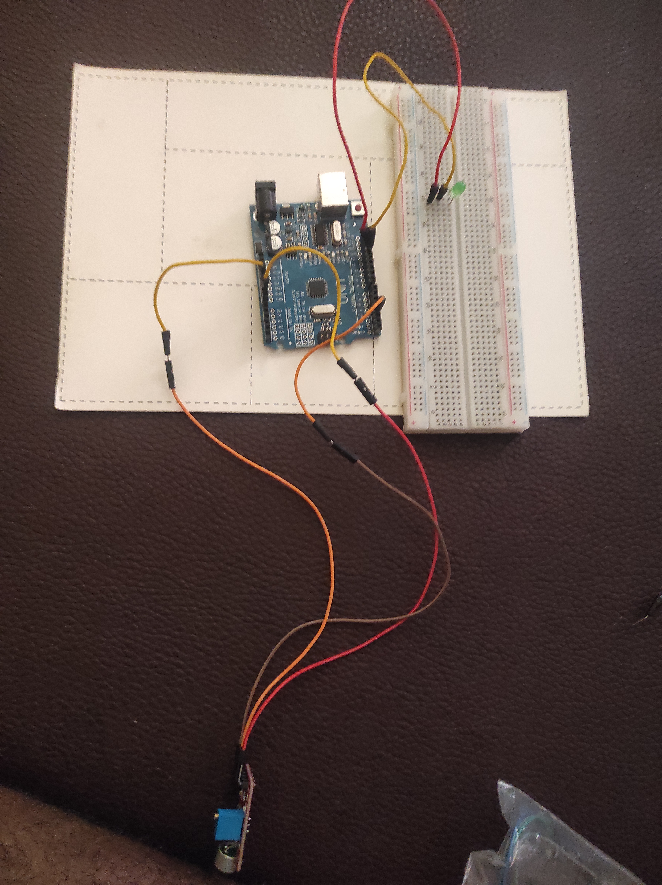
Circuit Design Picture

Slide 10
System Flow
System Operation:
Clap → Sound Sensor → Arduino → LED Control
First Clap: LED turns ON
Second Clap: LED turns OFF

Slide 11
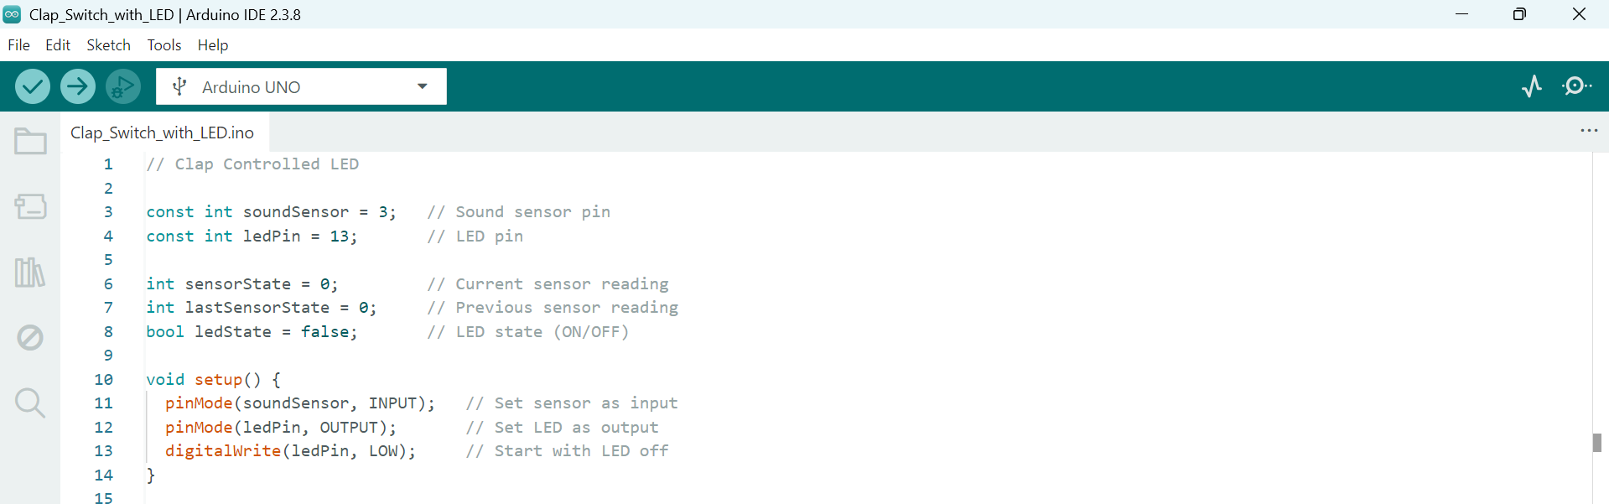
code

Slide 12
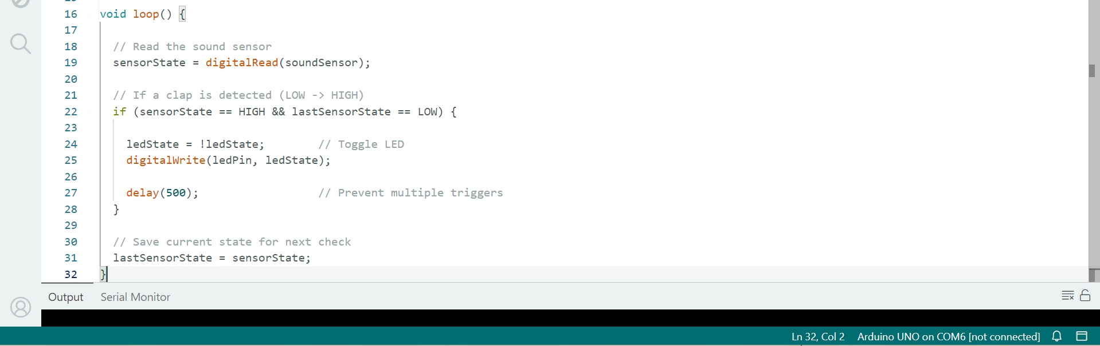
code

Slide 13
Code Overview
The Arduino program reads signals from the sound sensor.
When a sound is detected, the Arduino toggles the LED state.
This is achieved using conditional statements and digital input/output pins.

Slide 14
Demonstration / Simulation
Steps:
1. Power the Arduino circuit.
2. Clap near the sound sensor.
3. The sensor detects the sound.
4. Arduino processes the signal.
5. LED turns ON or OFF.

Slide 15
Results, Challenges, and Possible improvement
Results
Successful clap detection
LED toggled correctly
Challenges
Background noise interference
Sensor sensitivity adjustment
Improvements
This project comes with its flaws and some improvements we would like to have is to improve noise filtering , also implementing a double clap to toggle the LED, expanding the LED to more than one and possibly integrating a mobile app to control bulbs/LEDs in the household

Slide 16
conclusion
This project demonstrates a smart home lighting system that uses sound as the trigger, implementing an Arduino uno microcontroller and a sound sensor. This shows how simple sensors and microcontrollers can be used to create basic home automation solutions that improve convenience and accessibility.

